Slide 1


PROJECT PRESENTATION
Government Schem

Slide 2
PROJECT PRESENTATION
Government Schem
INTRODUCTION
JAYESH PATEL
JAIMIN PARMAR
JAYRAJSINH PARMAR
Assistant Professor Kalpana Prajapati
GUIDE BY :

Slide 3

PROJECT PRESENTATION
OBJECTTIVE
"Our objective is to create a user-friendly and secure government scheme portal that provides comprehensive information about various government schemes and enables users to access relevant services easily. The website aims to serve as a centralized hub for citizens to explore available schemes, understand their eligibility, and conveniently apply for the ones that suit their needs.
Informative Platform: Offer a comprehensive database of government schemes, providing users with detailed information on each scheme's objectives, benefits, eligibility criteria, and application process
Easy Application Process: Streamline the application process by providing step-by-step guidance, document checklists, and easy-to-understand forms, ensuring a seamless application experience for users.
Transparency and Trust: Foster trust among users by providing accurate, up-to-date, and transparent information on government schemes, thereby encouraging more citizens to benefit from the available initiatives.

Slide 4

PROJECT PRESENTATION
TOOLS AND TECHNOLOGY
Bus Tracking app
React.js
HTML
CSS
Fire Base
JavaScript
Figma
Visual Studio Code
State the purpose of the discussion
Identify yourself

Slide 5

PROJECT PRESENTATION
Bus Tracking app
ADVANTAGE
LIMITATION
Centralized Information Access
Enhanced User Experience
Efficient Application Process
Increased Outreach and Utilization
Digital Divide
Data Security and Privacy Risks
Digital Literacy Barriers
Maintenance and Updates

Slide 6
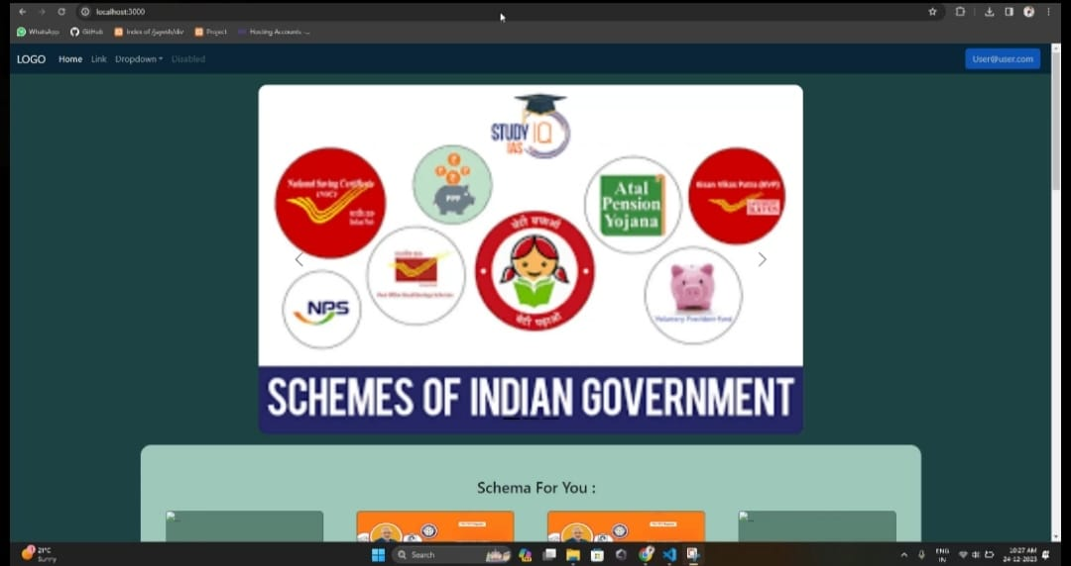
PROJECT PRESENTATION
Bus Tracking app
DEMO
Basic Home Page
State the purpose of the discussion
Identify yourself

Slide 7
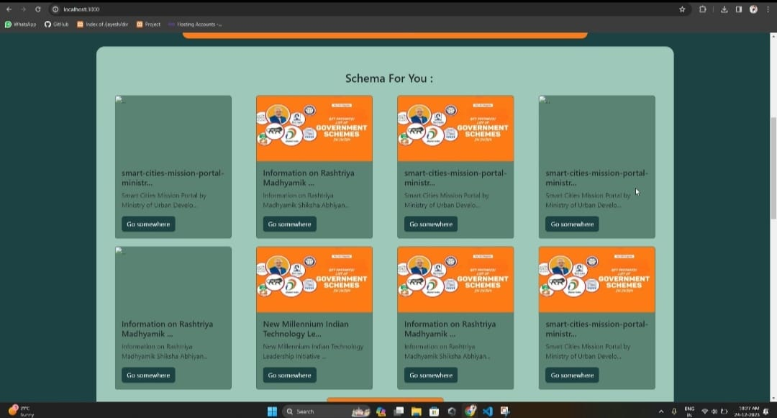
PROJECT PRESENTATION
Bus Tracking app
DEMO
Basic Home Page
State the purpose of the discussion
Identify yourself

Slide 8
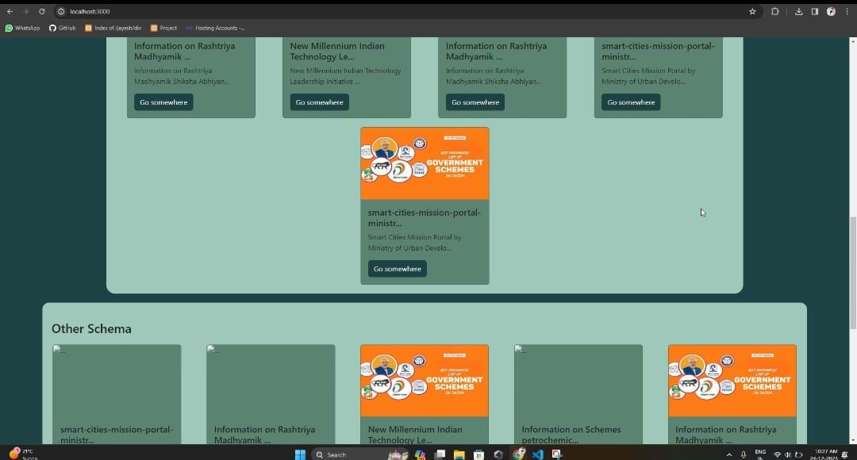
PROJECT PRESENTATION
Bus Tracking app
DEMO
Basic Home Page
State the purpose of the discussion
Identify yourself

Slide 9
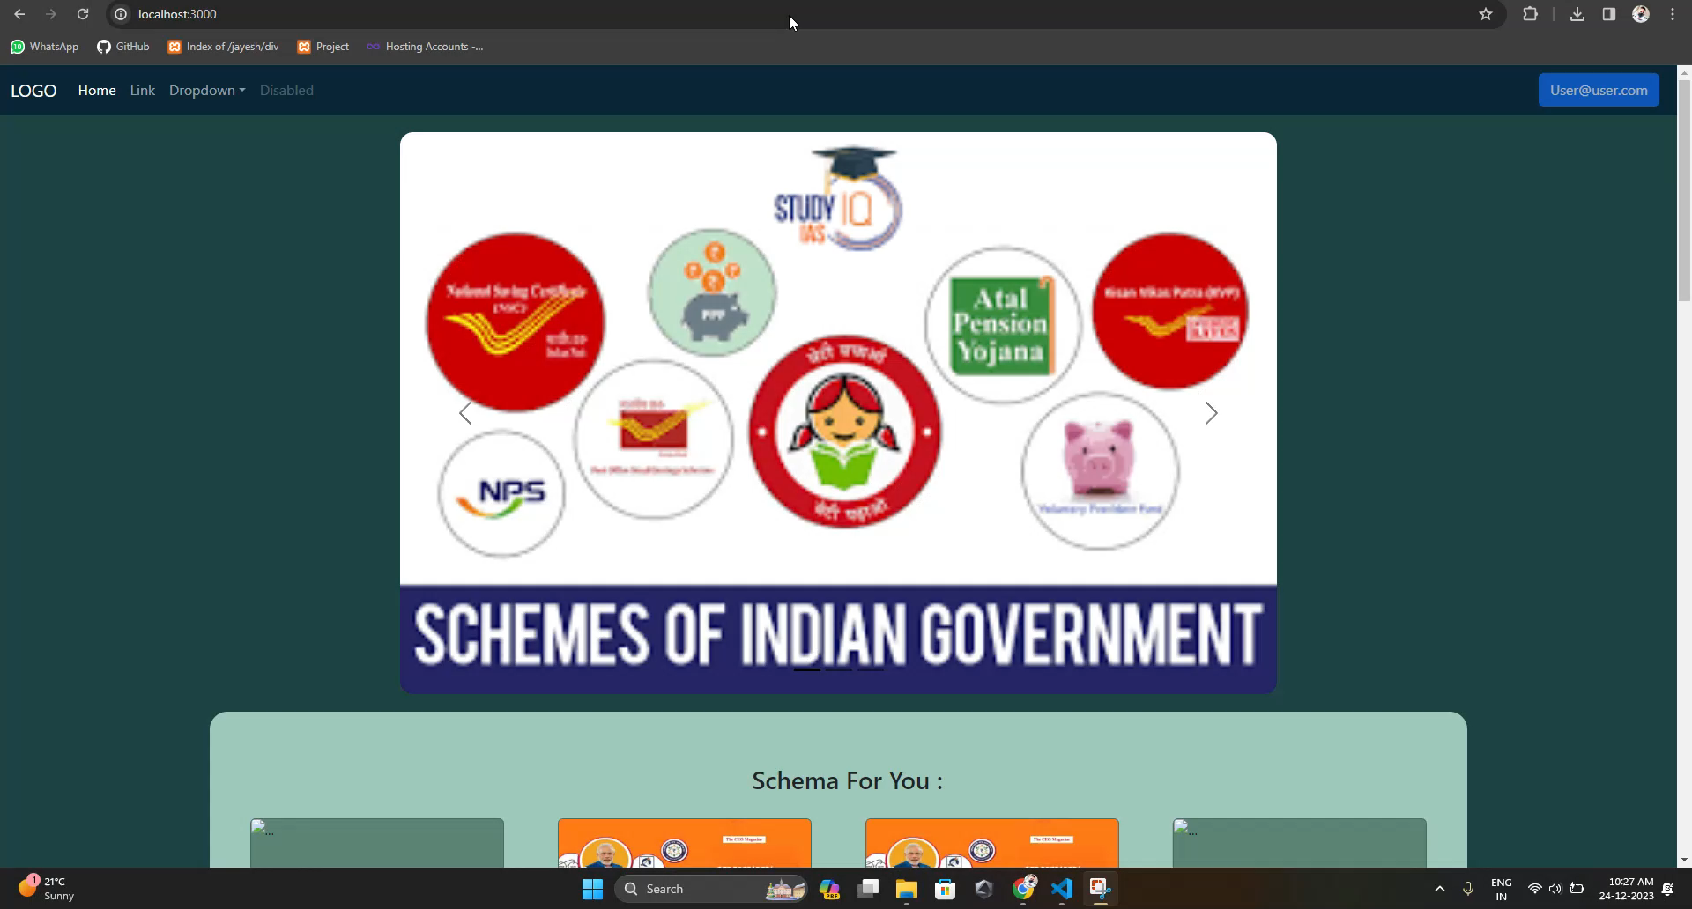
EXAMPLE

Slide 10


PROJECT PRESENTATION
LIMITATION
ADVANTAGE
Time solving
Real time bus tracking
Smart way to nus tarcking
Easy to interact with each other
Requires smart phone
Requires mobile data on
Requires GPS on
Requires collage ID
ASK ANY QUATION?

Slide 11

PROJECT PRESENTATION
LIMITATION
ADVANTAGE
Time solving
Real time bus tracking
Smart way to nus tarcking
Easy to interact with each other
Requires smart phone
Requires mobile data on
Requires GPS on
Requires collage ID
THANK YOU
ASK ANY QUATION?

